Slide 1

Diabetes Prediction: A Machine Learning Approach

Slide 2



Diabetes Prediction: A Machine Learning Approach
Group Members
Md Saiyem Raiyan
2012468042
Sheikh Mohammed Wali Ullah
2021186042
Zobaer Ahammod Zamil
2021796042

Slide 3
Overview
Dataset Overview
Data Analysis and Preprocessing
Feature Selection
Determining Test Size Using Cross-Validation Score
Model Training
Comparison & Conclusion

Slide 4
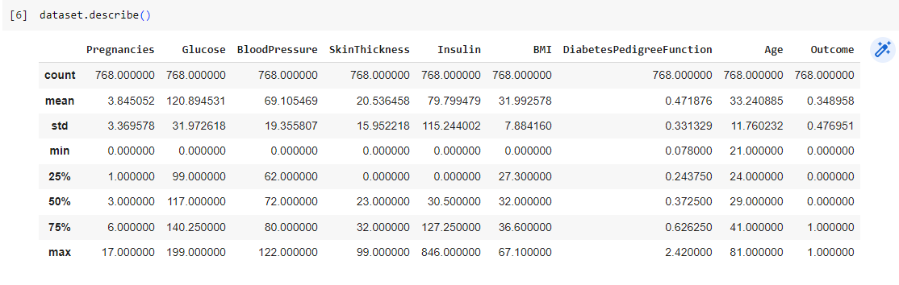
Dataset Overview
We collected this dataset from kaggle. The link of the dataset is given below:
https://www.kaggle.com/datasets/akshaydattatraykhare/diabetes-dataset
It contains:
768 rows
09 columns

Slide 5
Data Analysis and Preprocessing
Check if there any null values
Check the duplicate values in each rows and columns
Check Unique values for each Attributes
Check Outlier by plotting and counting
Check the Correlation between the attributes those have large number of outlier and Target attribute
Handle the outlier with threshold
Replace null values with mean

Slide 6
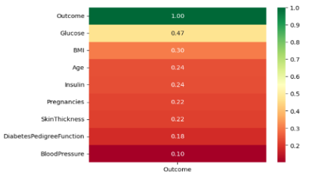
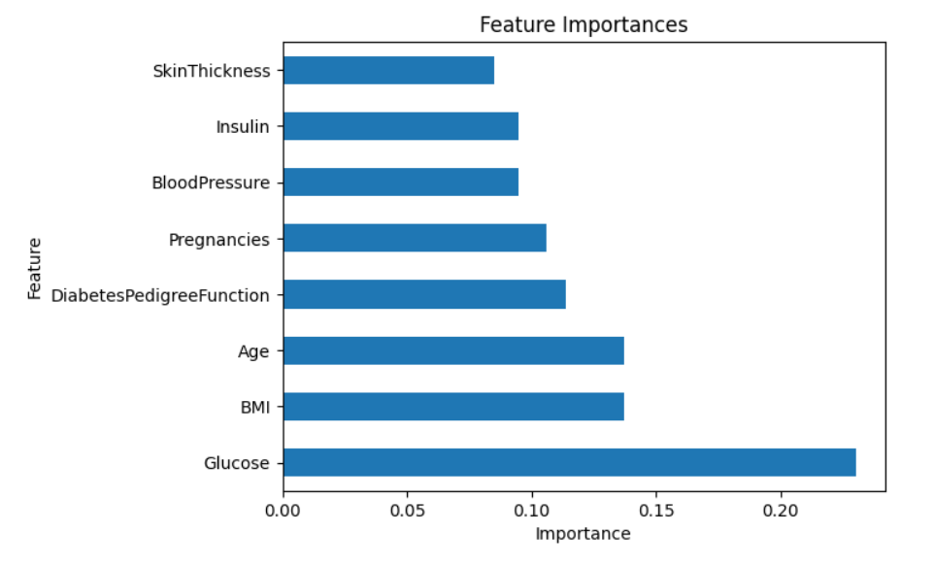
Feature Selection
Check the Correlation of Target attribute
and remaining attributes
Combining SelectKBest with
ExtraTreesClassifier

Slide 7
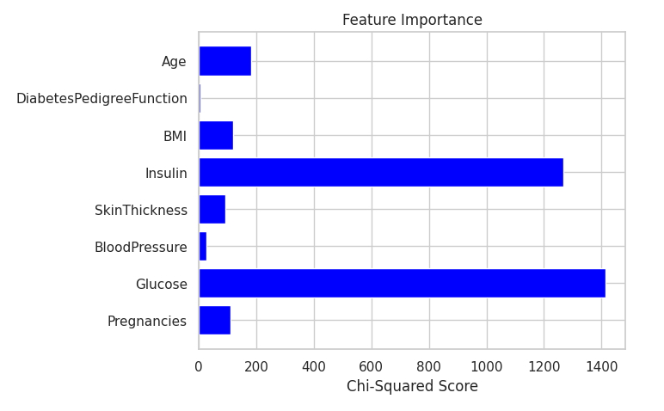
Feature Selection
Used Ranking of features using SelectionKBest
After observing these three processes, we can see that all features should be included in model training.

Slide 8
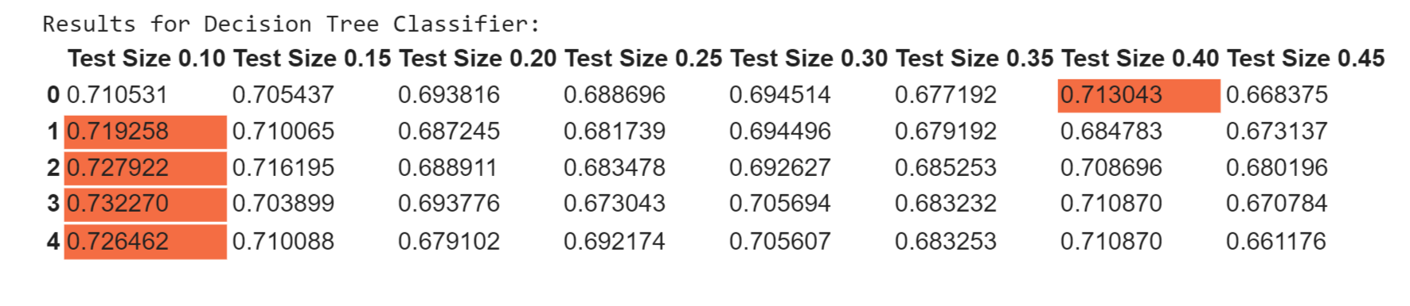
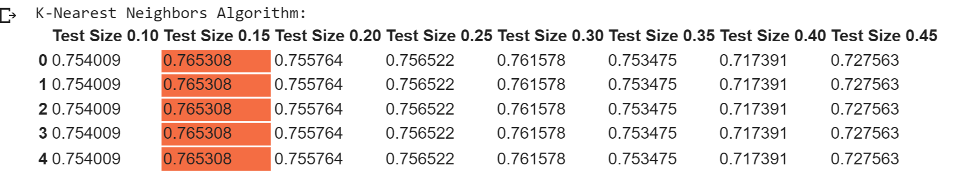
Determining Test Size Using Cross-Validation Score Score
We use K-fold for four algorithms
1.
2.

Slide 9
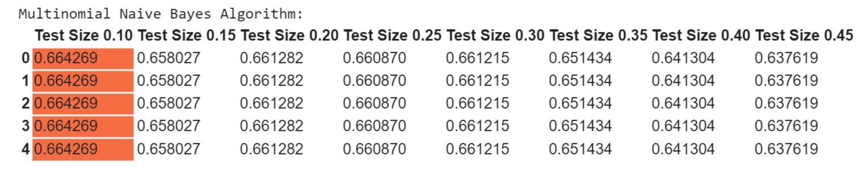
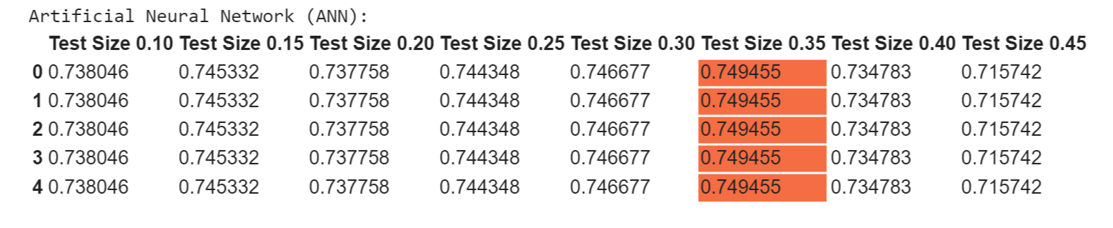
Determining Test Size Using Cross-Validation Score Score
We use K-fold for four algorithms
3.
4.

Slide 10
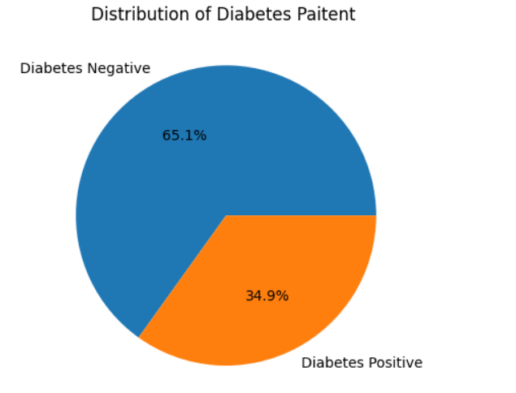
Determining Test Size Using Cross-Validation Score Score
We can say that the most effective splitting for this dataset is 80% for the train set and 20% for the test set in all models.

Slide 11
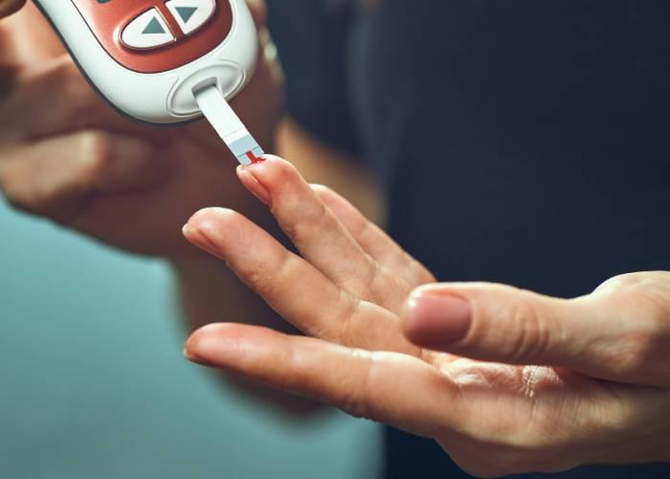
Model Training
By using k-fold validation, we found 80-20 splitting sets.
In these following models, 80% will be training set, and 20% will be test set
1. Decision Tree Algorithm (DTC)
2. K-Nearest Neighbors Algorithm (KNN)
Used StandardScaler()
3. Naive Bayes Algorithm (NB)
4. Artificial Neural Network Algorithm (ANN)
Used StandardScaler()
Training Set Test Set
80%
20%

Slide 12
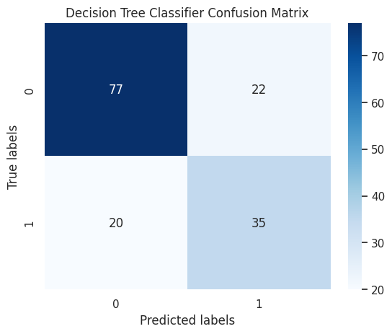
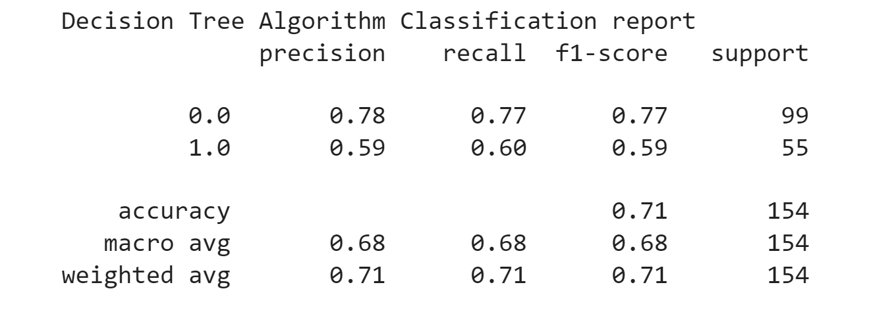
1. Decision Tree Algorithm

Slide 13
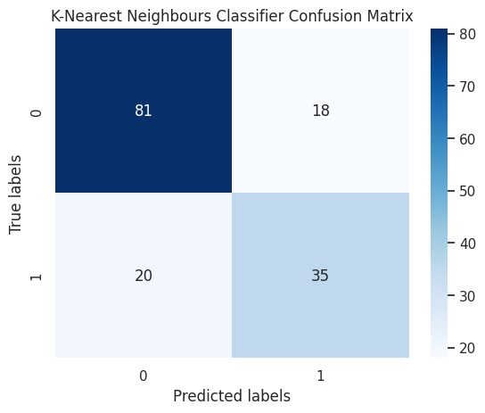
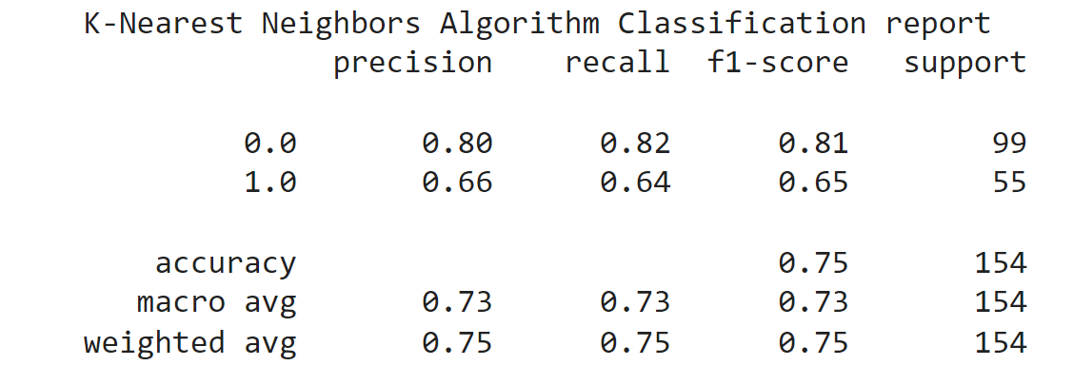
2. K-Nearest Neighbors Algorithm

Slide 14
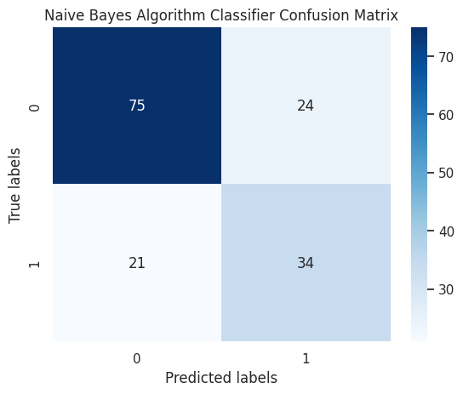
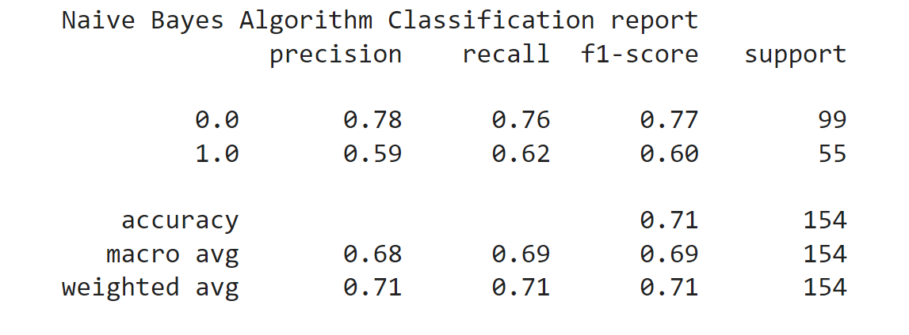
3. Naive Bayes Algorithm

Slide 15
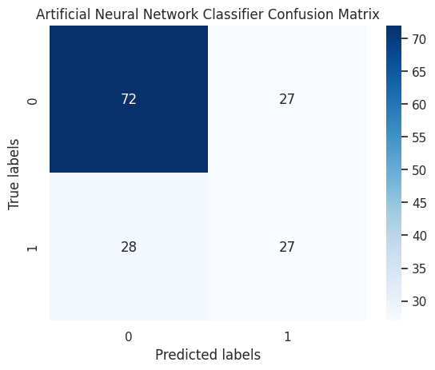
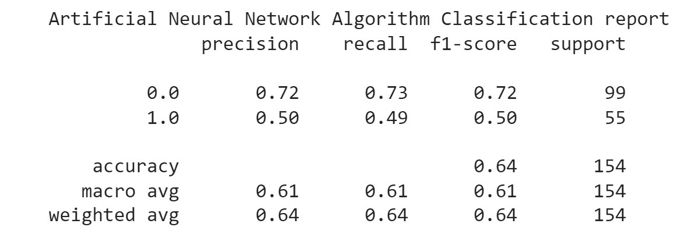
4. Artificial Neural Network Algorithm

Slide 16
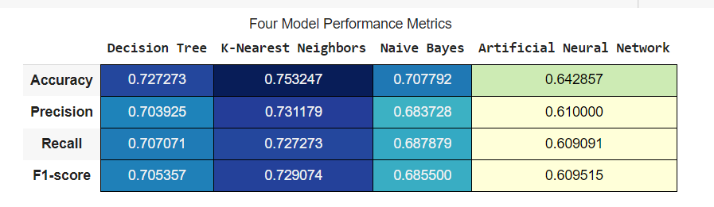
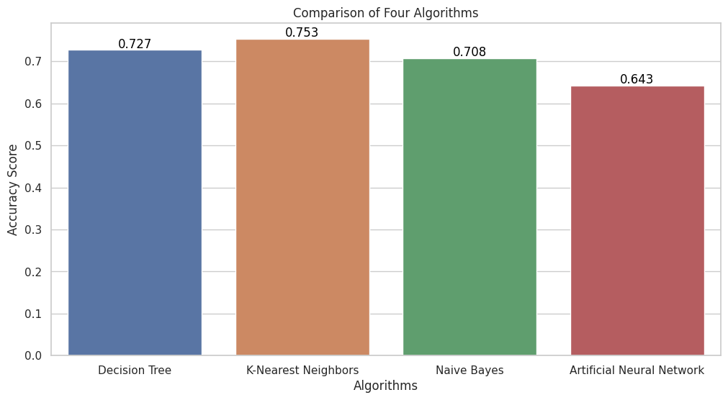
Comparison
DTC
KNN
NB
ANN

Slide 17
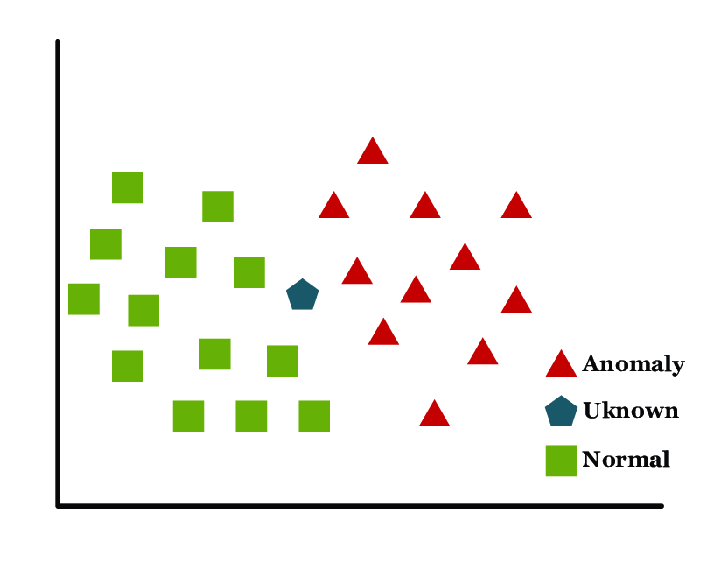
Conclusion
Among these models, KNN was the best model.
After that, DT gave the second-highest accuracy.

Slide 18

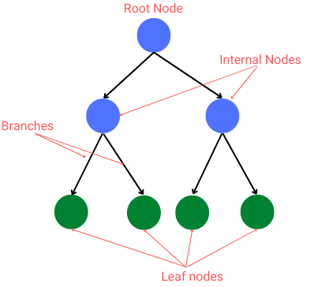
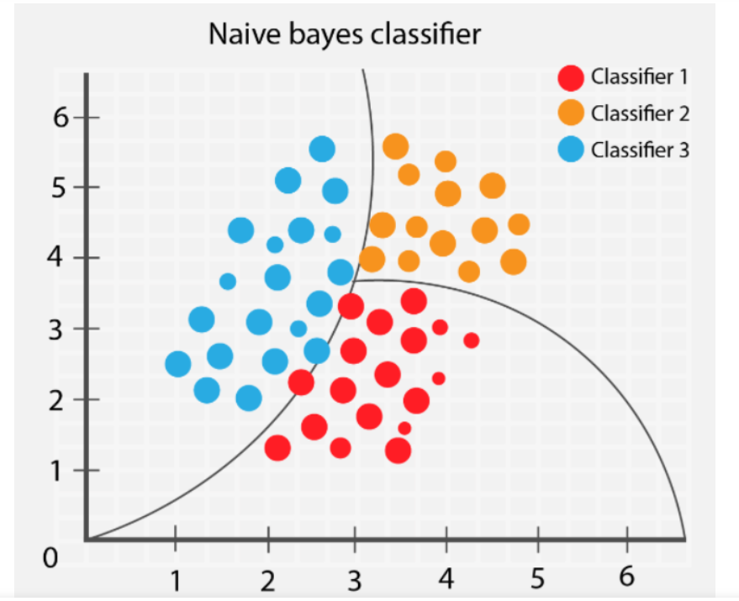
Thank you!

